Slide 1
Diversification And Refinement In Collaborative Filtering Recommender
Date: 2012/02/16
Source: Rubi Boim et. al (CIKM’11)
Speaker: Chiang,guang-ting
Advisor: Dr. Koh. Jia-ling

Slide 2
Index
Introduction
Priorty-Cover-Tree
Priority-medoids
Recommendation refinement
Experiments
Conclusion

Slide 3
Introduction
E-commerce has grown rapidly over the past few years.
An important advantage of e-commerce is the great variety of items that online stores offer.

Slide 4
Introduction
Motivation :
Notes:
Motivation:
With large number of items,it becomes harder for vendors to determine which items are more relevant for a given user and, given the limited size of the screen, which of these possibly relevant items should be presented ﬁrst.
Goal:

Slide 5
Introduction
Goal :
Proposes a novel technique for diversifying the recommendations that they give to users.
Provides a natural zoom-in mechanism to focus on items (clusters) of interest and recommending diversiﬁed similar items.

Slide 6
Diversity
Harry Potter – 1
Harry Potter – 2
Harry Potter – 3
Harry Potter – 4
Harry Potter – 5
Over-specialized !
Solving:
ranking + diversity
=>Use “Priority-medoids” to balance these two
“NP-hard” Problem
=>”Priorty-Cover-Tree”

Slide 7
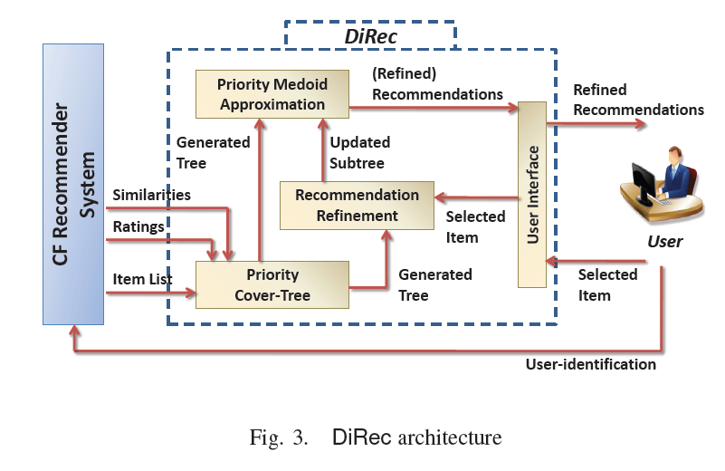

Slide 8
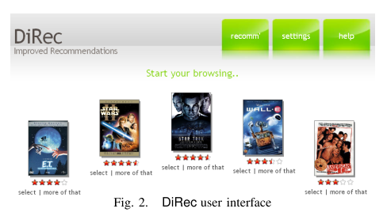
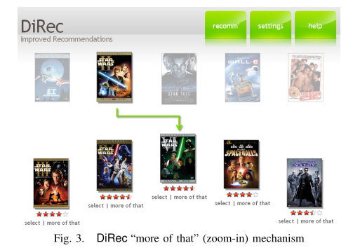

Slide 9
Estimations of similarity
Each item is viewed as a vector of ratings in a multi-dimensional speace :rate(i)
The distance between item vectors is then used as a measure for the items similarity:dist(i,j)

Slide 10
Priorty Cover-Tree(PCT)
Cover-tree : a data structure originally designed to speed up a nearest neighbor search.
The use of cover-trees as a tool for selecting medoids, in the context of diversiﬁcation of query results.
A key difference between Cover-tree and Priorty Cover-Tree is that item ratings were not taken into consideration.

Slide 11
Priorty Cover-Tree(PCT)
(Nesting) If a node is associated with an item $i$, then one of its children must also be associated with $i$.
(Separation) All nodes at level l are at least $\frac{1}{2^{l}}$ far from one another.
(Covering) Each node at level $l$ is within distance $\frac{1}{2^{l}}$to its children in level $l$+ 1.
(Priority) Each node has a rating higher or equal to that of any of its children.

Slide 12
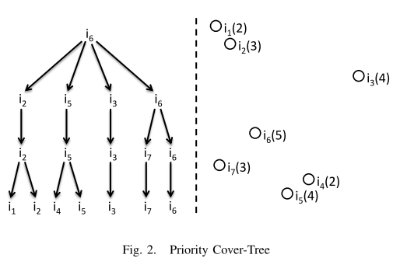
Priorty Cover-Tree(PCT)
rating
$${item}_{(rating)}$$
high
low

Slide 13
Construction
Priorty Cover-Tree(PCT)
Sorting the set I of items according to their rating, in a descending order.
InsertSingleItem() function .
This function ﬁnds the ﬁrst level into which the given item can be inserted.
It works in a recursive fashion.
But it may have several candidate nodes that may act as the item’s parent, we prefers the node with the smallest dist() measure to the inserted items.

Slide 14
Construction example
Ordered:
$i_{6}$ ,$i_{3}$ ,$i_{5}$ ,$i_{2}$ ,$i_{7}$ ,$i_{1}$ ,$i_{4}$
InsertSingleItem()
Check invariant 2, invariant 3.
invariant 2 | All nodes at level l are at least $\frac{1}{2^{l}}$ far fromone another
invariant 3 | Each node at level $l$ is within distance $\frac{1}{2^{l}}$to its children in level $l$+ 1.

Slide 15
Representative Selection
Priorty Cover-Tree(PCT)
$C_{l}$ to denote the set of nodes at level $l$
Starting from the tree root, we search for the ﬁrst level $l$ within the tree that includes at least k nodes.
We ﬁrst select the nodes (items) in $C_{l−1}$, then add the remaining k−|$C_{l−1}$|from within $C_{l}$−$C_{l−1}$.
The way of choosing remaining items:
Max-rating: the elements having the maximal ratings
Max-diversity: the elements that are farthest from the previously chosen elements
Max-coverage: the elements having the maximal number of descendants.

Slide 16
Representative Selection example
K=3.
The ﬁrst level that contains at least three items is the level 1.
|C1-C0|=2.
Max-rating: $i_{3}, i_{5}{,i}_{6}$
Max-diversity : $i_{2}, i_{3}{,i}_{6}$
Max-coverage : $i_{2}, i_{5}{,i}_{6}$

Slide 17
Recommendation refinement
Each item i that is presented on the screen, DiRec offers a “more of that” zoom-in button that allows the user to view further related items.
Priority-medoids
Update tree
Representative Selection
user
Priorty Cover-Tree
Refinement
Recommendations
Recommend item
Add, prune

Slide 18
Priority-medoids
Balancing rating and distance.
Medoids: (cluster’s representative) is an element in the cluster s.t. the sum of the distances from it to the other items in the cluster is minimal.
Priority-medoids :
the representatives are the ones having highest
rating in their corresponding clusters.

Slide 19
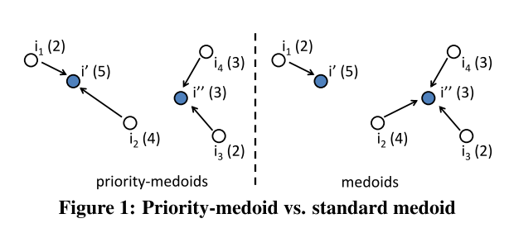
Priority-medoids
$${item}_{(rating)}$$
Ex:K=2, $I_{k}$=(I’, I”), Similarity=euclidian distance .
Identifying the best priority-medoids is NP-hard (the proof is by reduction to the problem of ﬁnding best regular medoids, also known to be NP-hard)

Slide 20
Recommendation refinement
Ex: k=3, Max-divesity, representation= $i_{2}, i_{3}{,i}_{6}$.
- assume click $i_{6}$
- check rel($i_{6}$)
$$i_{5}$$
$$i_{5}$$
$$i_{7}$$
$$i_{5}$$
$$i_{4}$$
$$i_{7}$$
Update tree

Slide 21
Experiments
Implemented the above algorithms in DiRec , a plug-in that allows CF Recommender systems to diversify the recommendations that they present to users.
Experiments setting:
Data: provided by Netﬂix, 100 million distinct raw movie ratings (such as 1 to 5 “stars”), by almost 500,000 users, and no semantic information on the movies

Slide 22
Experiments
Algorithms: (PCT stands for Priority Cover-Tree)
PCT-R : Max-rating,
PCT-D: Max-diversity
PCT-C: Max-coverage
CT: Cover-Tree(did’t consider rating)
Swap: use predeﬁned thresholds to balance rating and diversity
optR: selecting the k items having highest rating and ignoring diversity.
optD: ignores the rating of items and selects k items whose pairwise distance values is the highest.

Slide 23
Randomly chose a set of 1000 users from the Netﬂix data set and run the experiment for each of them.
The results presented here are the average of all 1000 users, k=5.
Rating($I_{k}$)=$\sum_{i,j∈I_{k}}{rate(i)}$
diversity($I_{k}$)=$\sum_{i,j∈I_{k}}{dist(i,j)}$

Slide 24
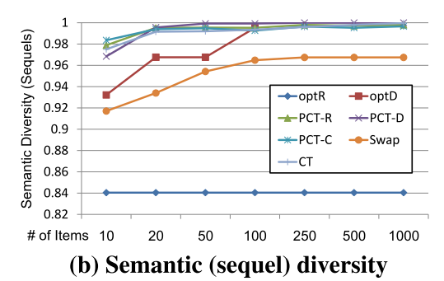
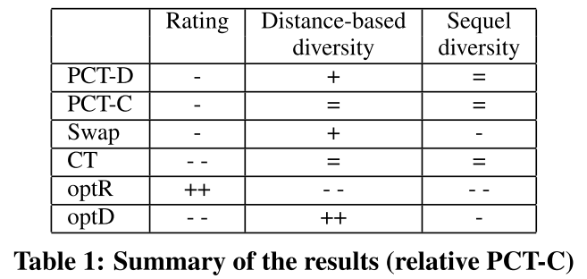
sequelDivers($I_{k}$)=$\frac{\left|sequel\left(i\right)|i∈k\right|}{k}$
-R

Slide 25
Conclusions
Priority-medoids that declaratively balances the rating and the diversity of the recommended items.
Priority cover-trees as a tool for efﬁcient selection of item representatives.
DiRec allows for an effective realization of a natural “zoom-in” mechanism,presenting to users similar yet diversiﬁed items.
Experiments demonstrated the effectiveness of our recommendation diversiﬁcation technique and its superiority over previous proposals.

